Slide 1

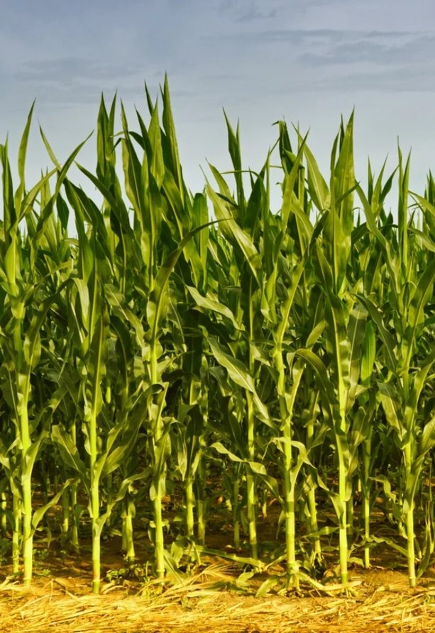
WELCOME
ASSOCIATE
MEMBERS
This TFI member communication is provided for informational purposes only and should not be construed as advice, legal or otherwise. The content in this communication is intended for the exclusive use of TFI member companies and should not be shared outside your organization, including media outlets, without specific approval from TFI.

Slide 2

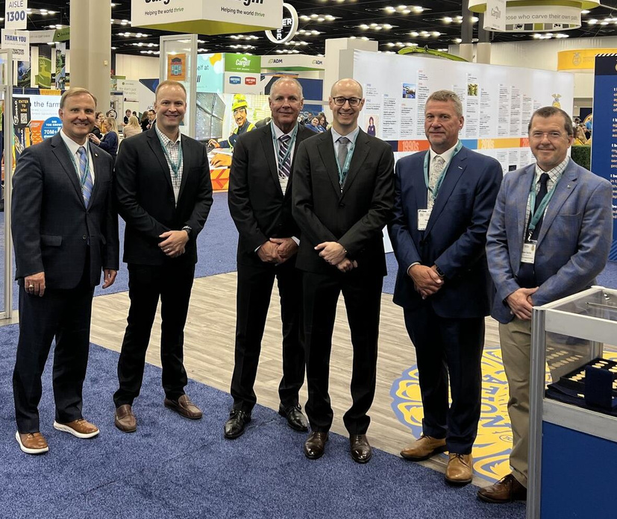

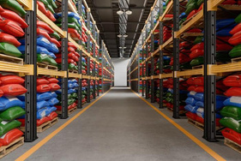

MANUFACTURERS
BIOSTIMULANTS
THE FERTILIZER INSTITUTE (TFI)
PROUDLY REPRESENTS THE ENTIRE VALUE CHAIN
RETAILERS
BIOSTIMULANTS
INDUSTRY SUPPLIERS
INDUSTRY SUPPLIERS

Slide 3
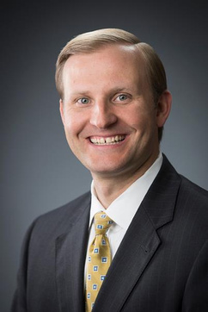
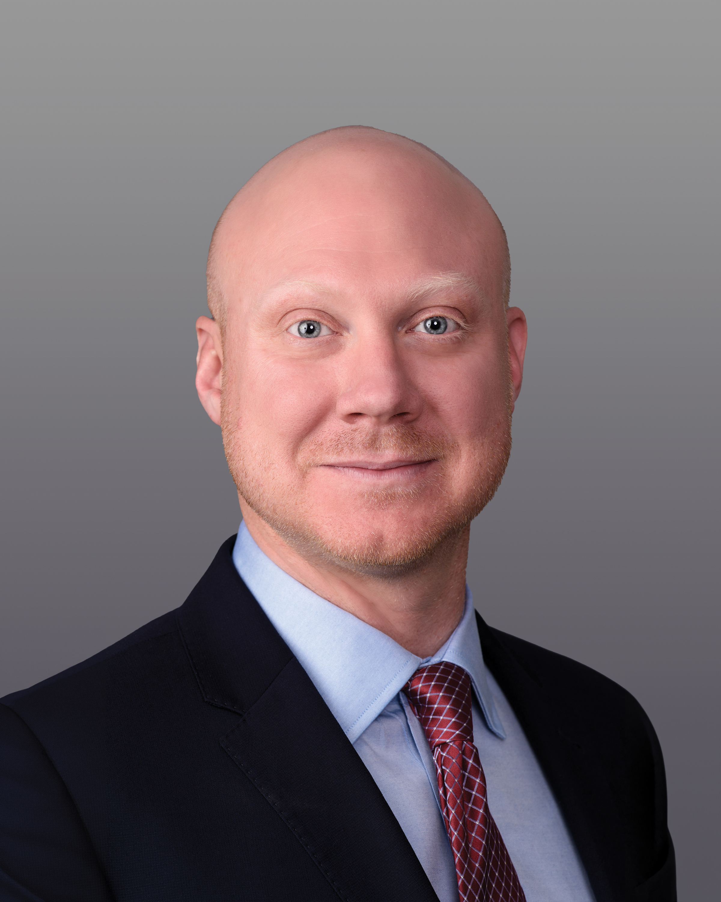
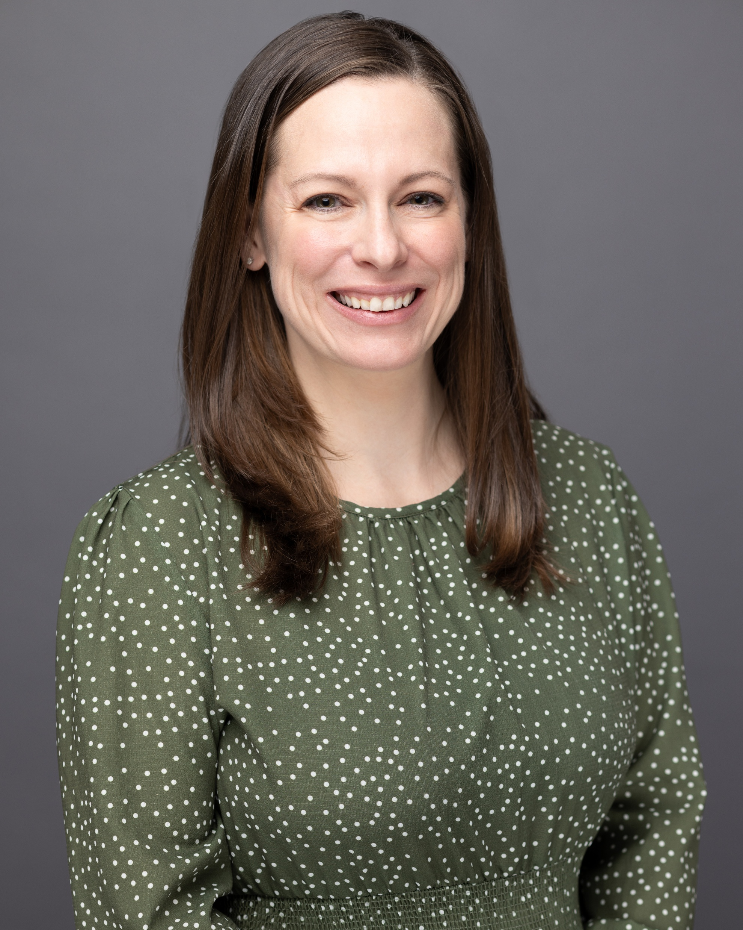
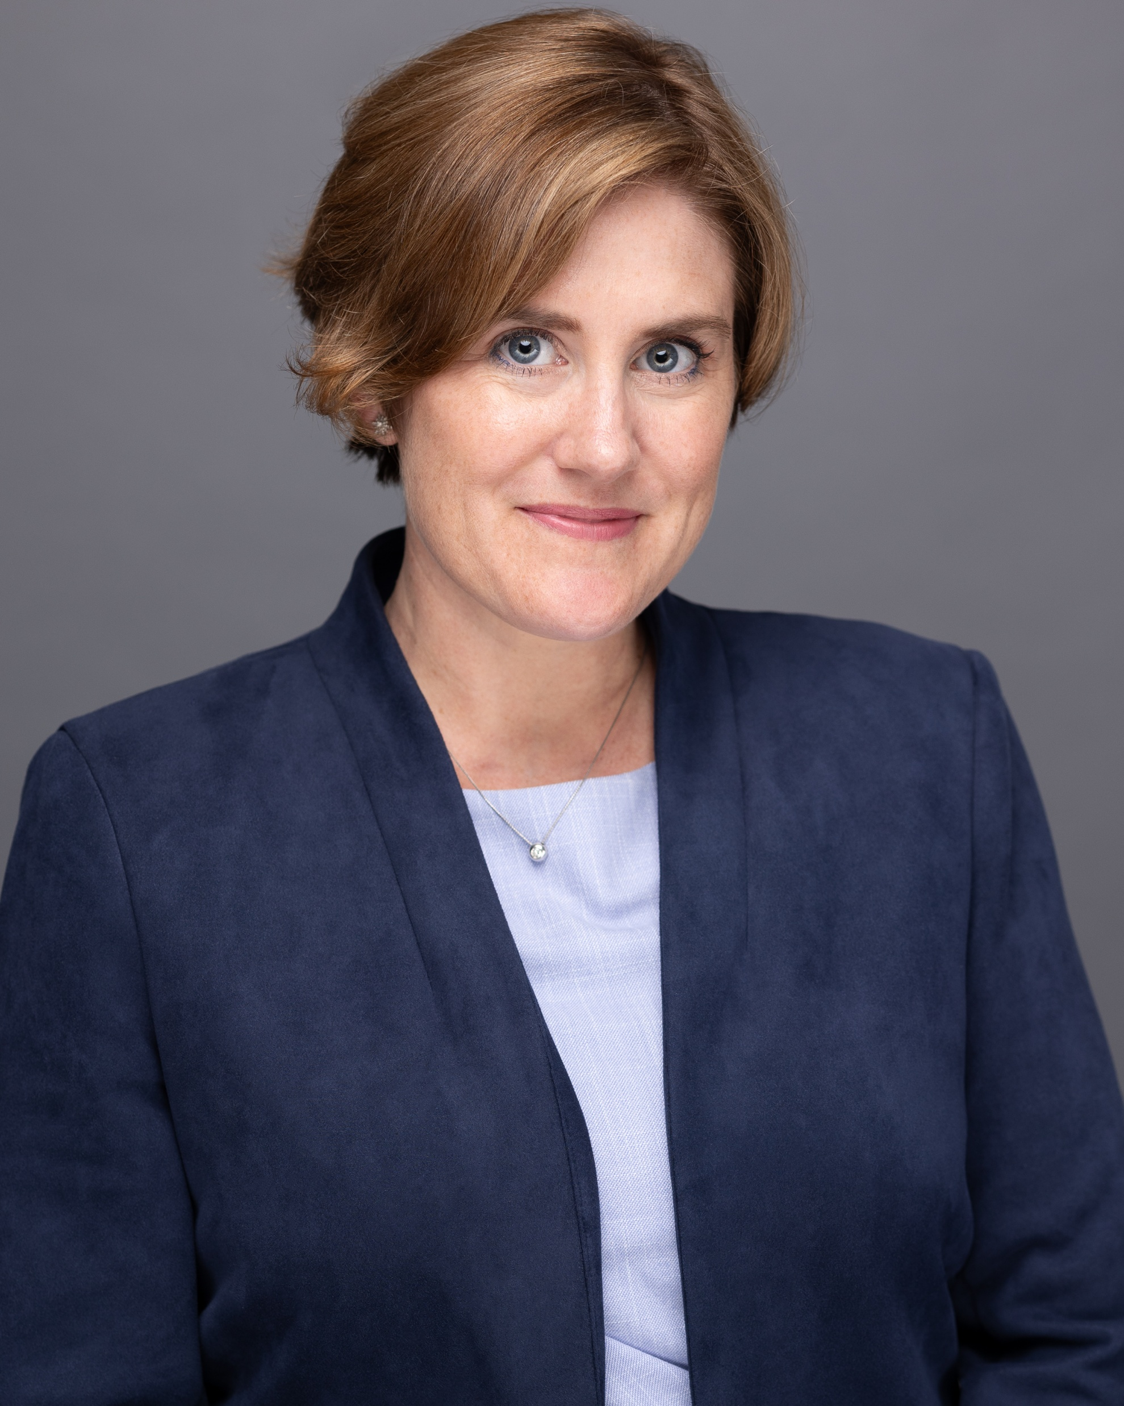
MEET THE TEAM
+
Corey Rosenbusch
+
Chris
Glen
+
Veronica Nigh
+
Melinda Sposari
President and CEO
VP, Public Affairs
cglen@tfi.org
Chief Economist
vnigh@tfi.org
VP, Membership
msposari@tfi.org

Slide 4
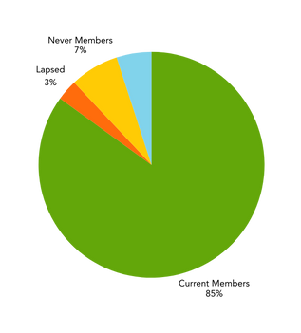
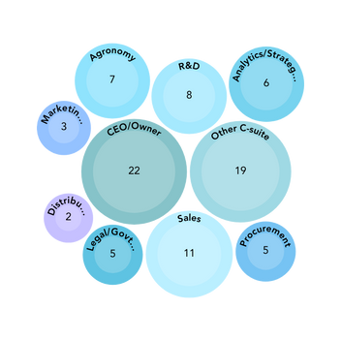




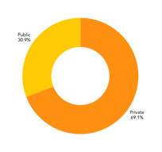


Respondent Summary
131 Industry Professionals completed the survey
Type of Business
Governance
Job Position or Role
54% Primary Producer/ Manufacturer
29% Wholesaler
24% Retail
16% Trading/Distribution 9% Supplier
5% Import/Export Sales
Global HQ
Location Live
Business Size
32%
22%
8%
17%
20%
U.S.
Canada
UK
Other
69%
8%
5%
18%
U.S. Canada
UK
Other
89%
6%
2%
3%
<100 employees
100-499
500-999
1,000-4,999
5,000+
<$10M $10-$100M $100-500M $500-$1B $1B+
11% 15% 23% 5% 30%
Notes:
Everything we do is driven by the membership. We survey the industry to find out what the top influences on their business and the greatest influences on the overall industry. With your membership you have access to market information like this to help you better understand the fertilizer industry. Our main focus is on organizations that sell fertilizer on U.S. soil. The surveys help us to test hypothesis and ensure we are focusing on the key challenges and issues faced by the industry.

Slide 5
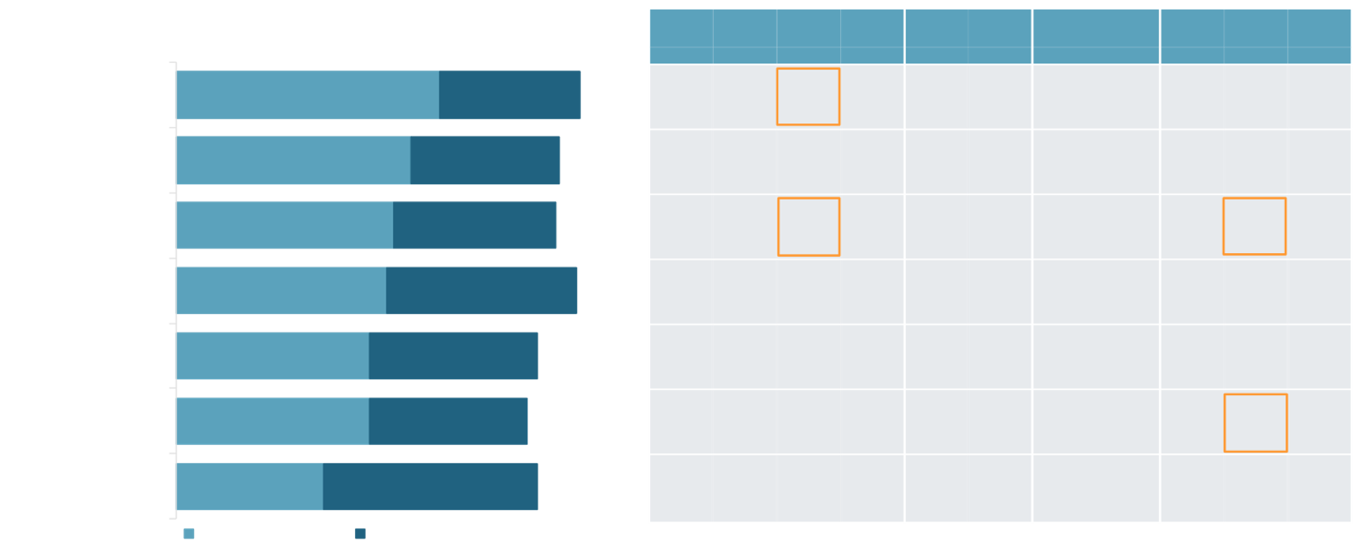




Top Industry Challenges
Regulatory uncertainty is the top challenge facing the Industry as a whole, followed by Government policy and regulations. A shortage of skilled labor is impacting U.S. companies – retailers, wholesalers, and mid-sized companies specifically.
Manu-
$100M-
Top Industry Challenges
Whole-sale
(n=38)
Retail
Other
C-level
Other
U.S.
Other
facturer
(n=71)
< $100M
$999M
$1B+
(n=39)
(n=32)
(n=44)
(n=54)
(n=77)
(n=91)
(n=40)
(n=34)
(n=36)
Regulatory uncertainty
57%
31%
88%
59%
58%
72%
52%
56%
58%
60%
50%
53%
56%
62%
Government policy/regs
51%
32%
83%
52%
61%
66%
52%
59%
45%
55%
43%
44%
56%
54%
Enough skilled labor
47%
35%
82%
38%
55%
75%
34%
56%
42%
58%
23%
35%
69%
33%
Top challenges differ from rest of Industry
Geopolitical Issues
46%
41%
87%
44%
53%
47%
36%
41%
49%
44%
50%
47%
39%
54%
Environment/ climate change
42%
37%
79%
45%
45%
41%
52%
44%
40%
41%
45%
38%
44%
51%
Transportation capacity/service
42%
34%
76%
46%
55%
53%
36%
44%
40%
43%
40%
21%
61%
49%
Macroeconomic Climate
32%
47%
79%
32%
24%
28%
30%
28%
35%
32%
33%
38%
31%
33%
Very challenging
Somewhat challenging
Indicates significantly higher/lower at the 90% confidence level

Slide 6
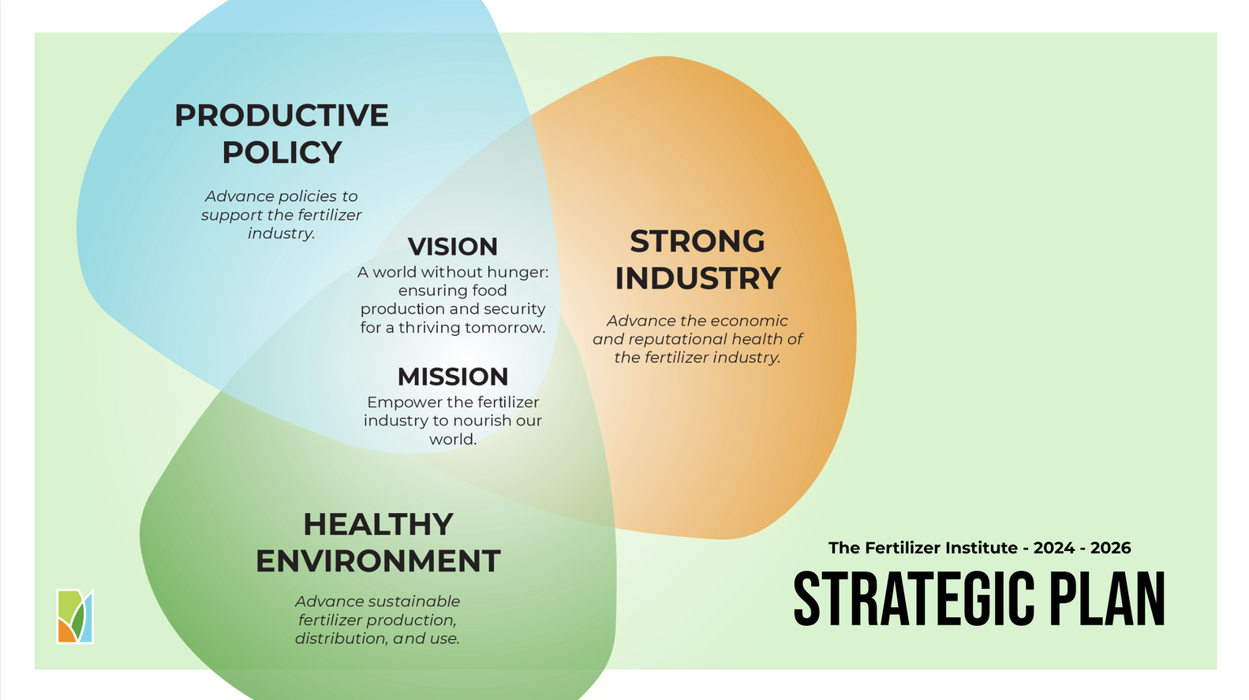

Slide 7
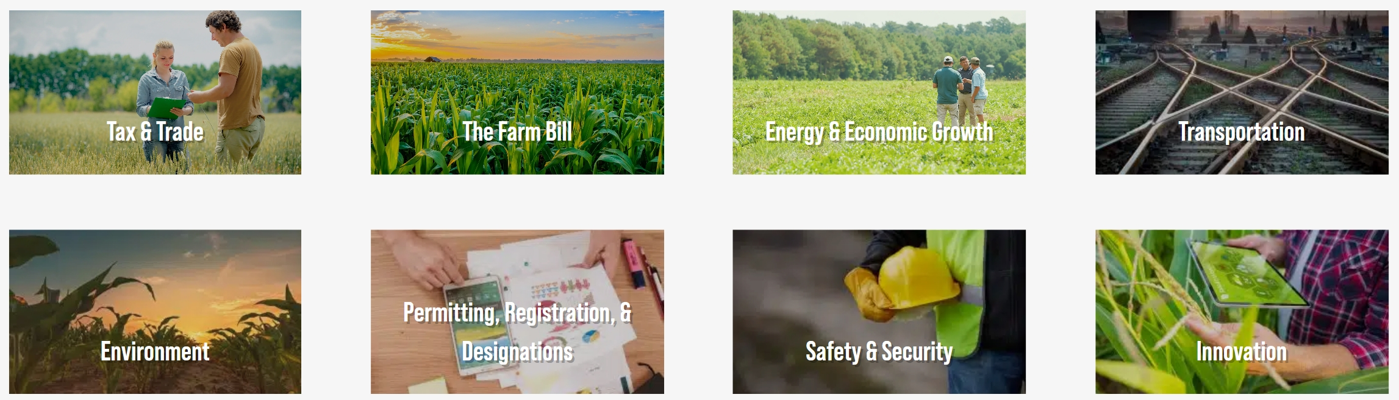

Policy Priorities 2025-2026

Slide 8

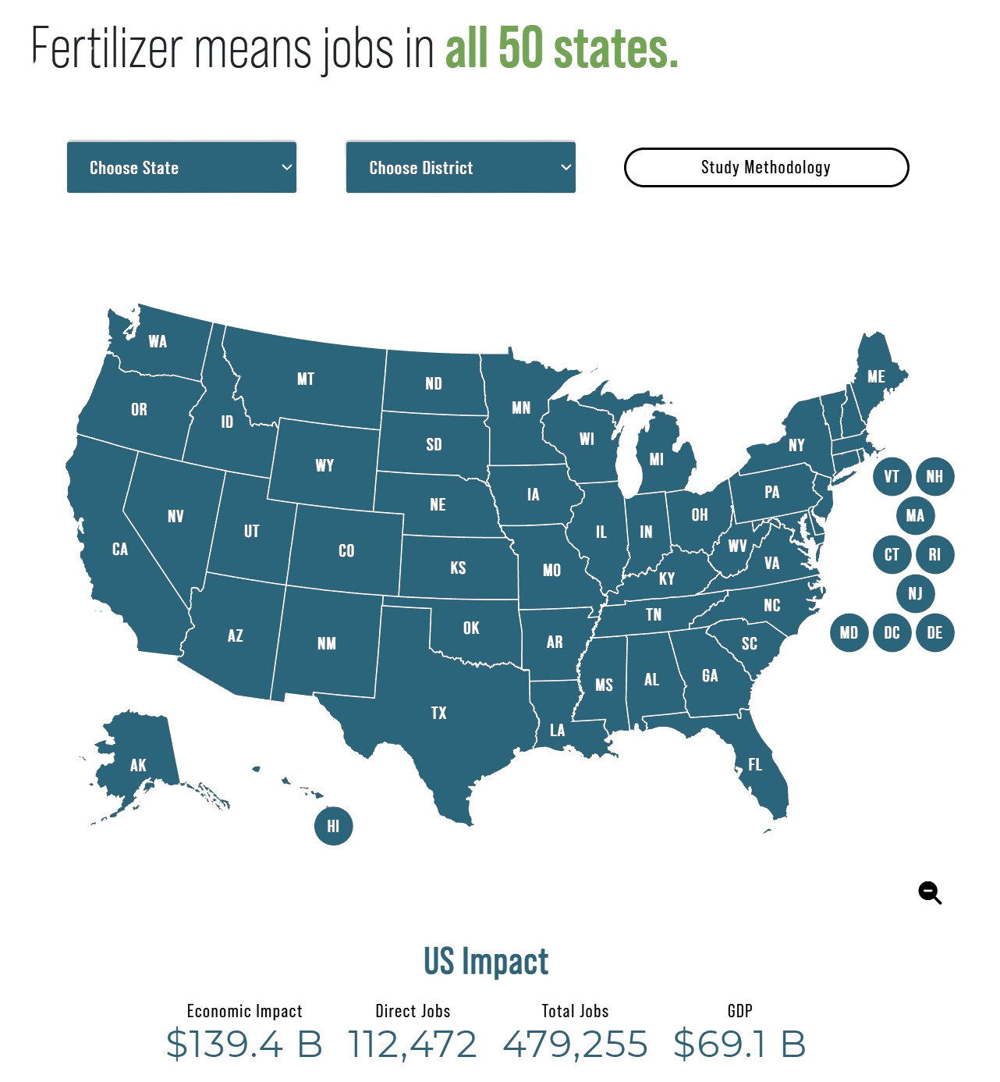
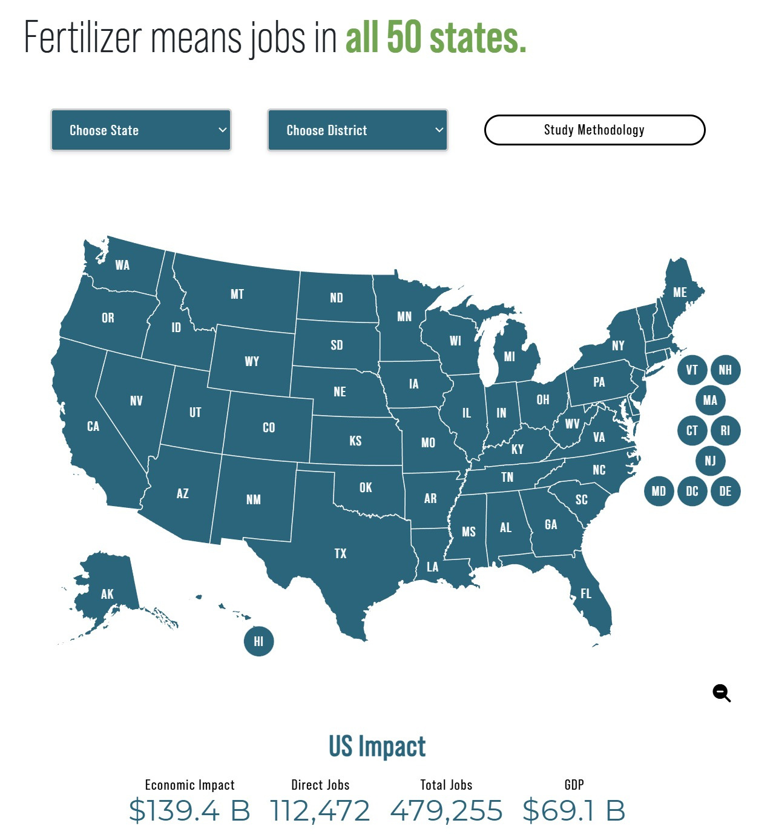
Economic Impact ​
Ask about our economic impact webinar
you can watch a recording of to learn more!

Slide 9
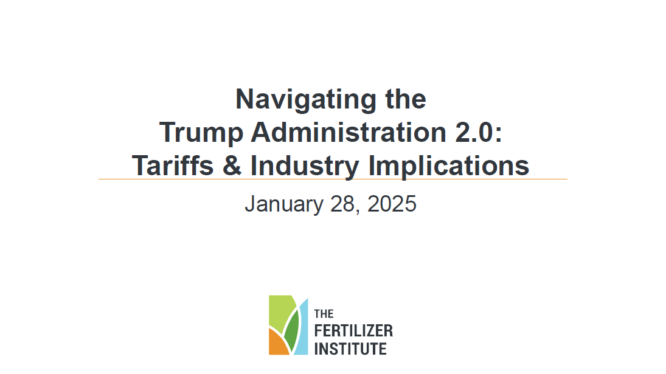


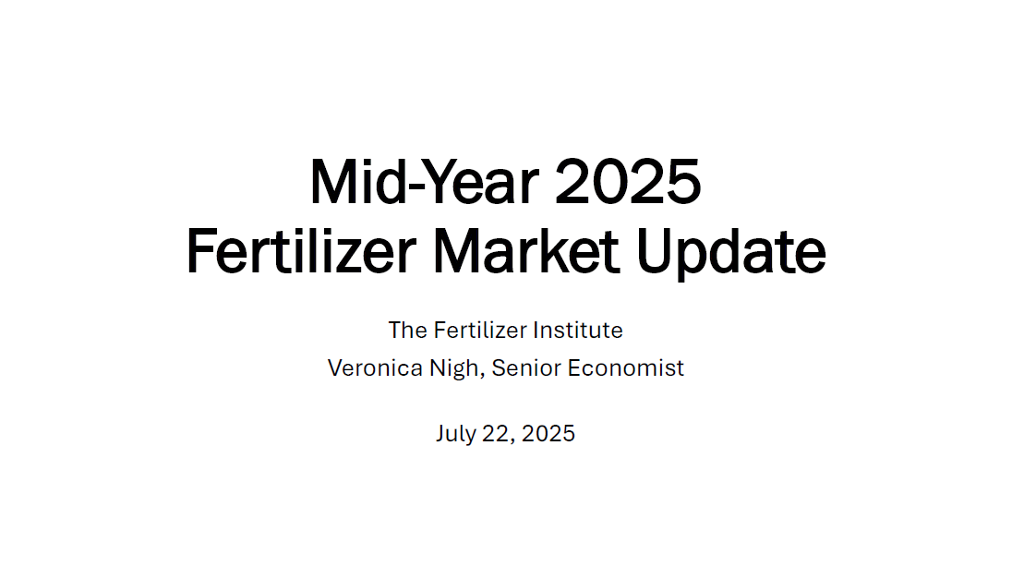
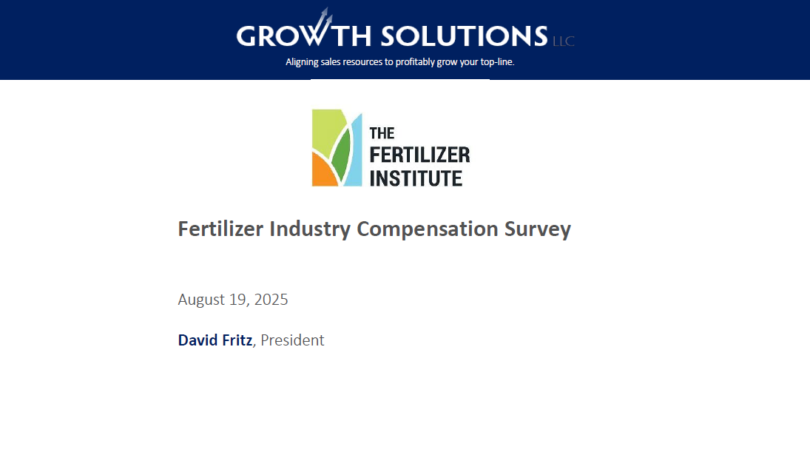

Webinars

Slide 10
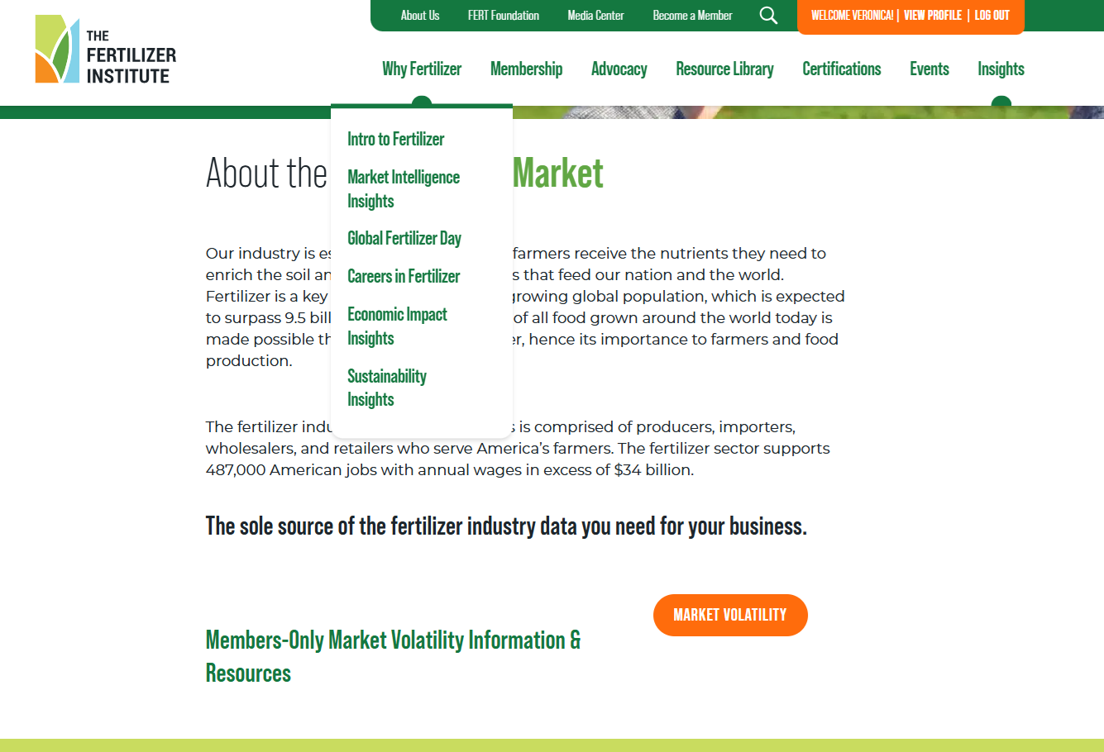
Members-Only Market Volatility
Information and Resources
  TFI remains committed to keeping our members up to date on fertilizer related issues, opportunities and challenges and especially right now given the current volatility in the marketplace.
  Fertilizer Market Update Deck (PPT and PDF)
  Fertilizer Market Volatility White Paper
  Market Volatility Key Takeaways
  Market Volatility Talking Points
  Commodity (N, P, K) One-Pagers
  Policy Solutions Document
  Coverage and Commentary on Other Market Reports:
    USDA’s Net Farm Income Forecast
    USDA’s Monthly Agricultural Prices Report
We’ll
come
back
to
this
on the next slide
Or
Then

Slide 11
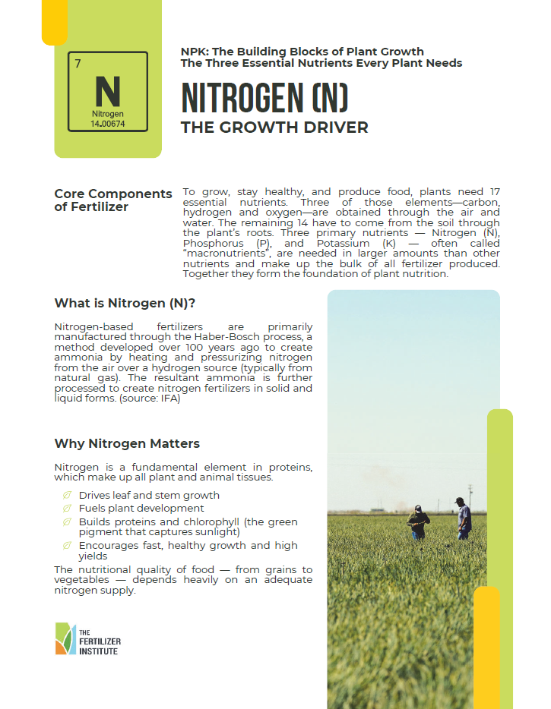
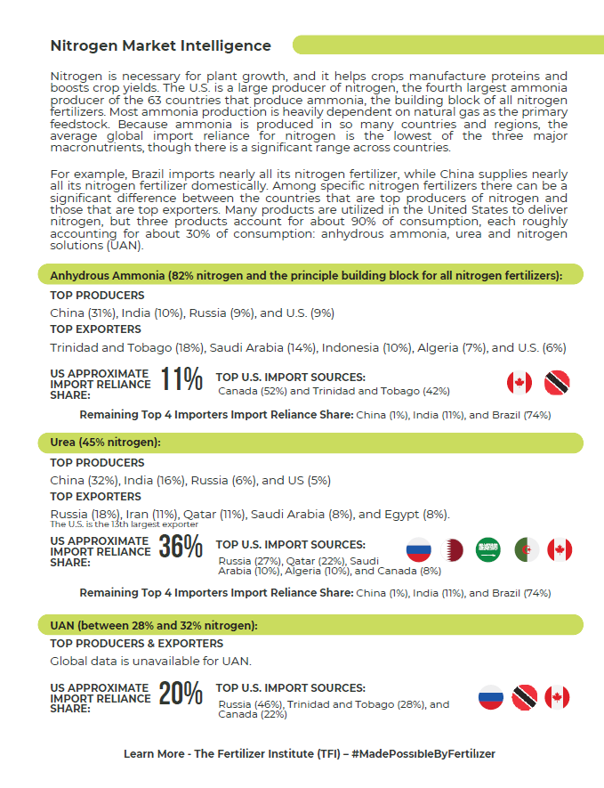
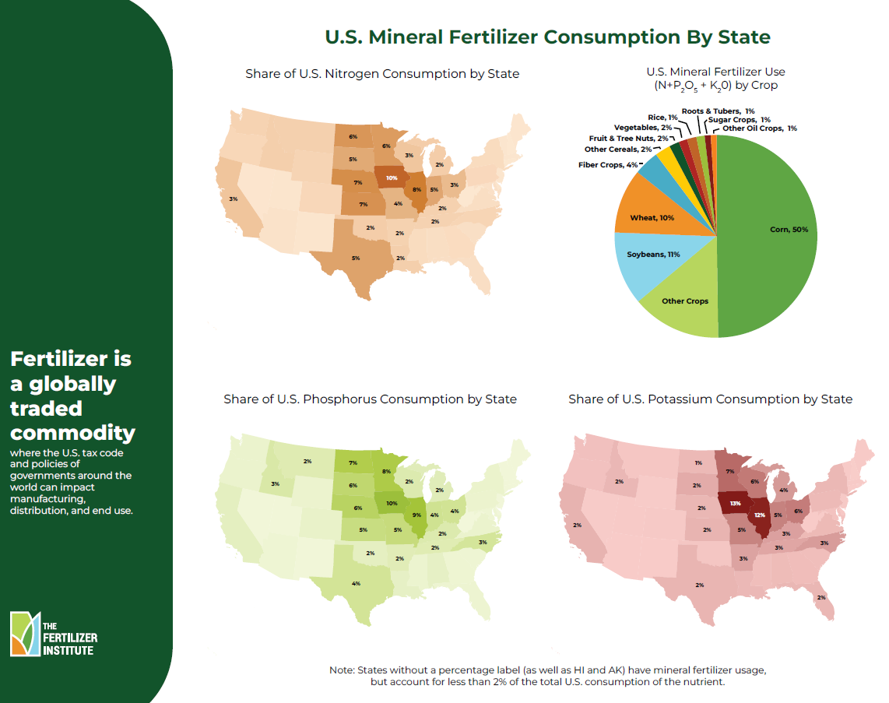
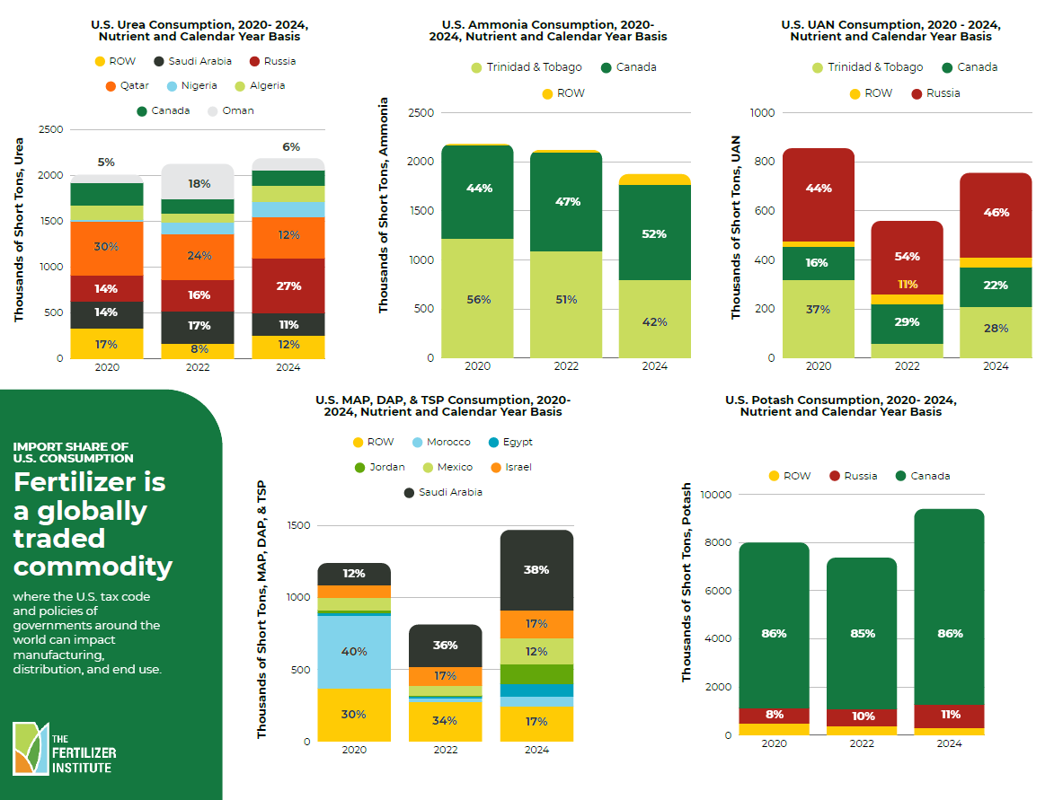
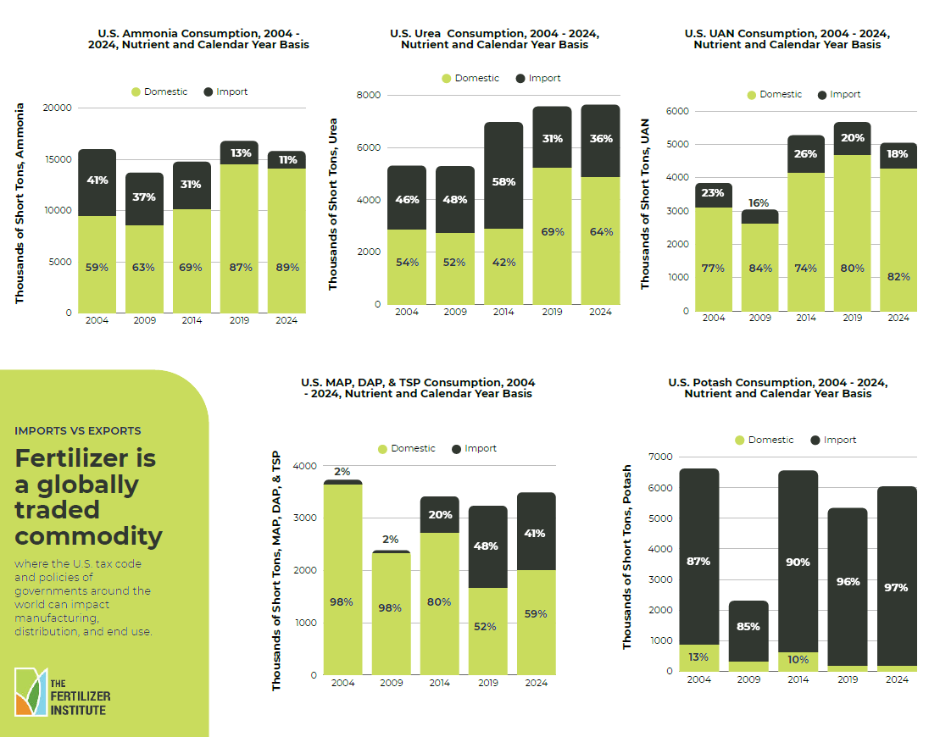
Public Facing Infographics and Other Resources
  Available Now in the Resource Library:
  Commodity (N, P, K) One-Pagers
  Import Share of U.S. Fertilizer Consumption
  U.S. Fertilizer Imports by Source
  U.S. Mineral Fertilizer Consumption by State
  U.S. Fertilizer Trade Flows by Month, by Nutrient
  Fertilizer Capacity Report
  What We’re Working On:
  Public-facing landing market intelligence landing page intended for a grower audience
  You tell us!

Slide 12
Other Purchasable Data
  TFI Stats -
  TFI collected and published monthly reports:
  Fertilizer RECORD Report
    Details production, producer closing inventories and producer disappearance of nitrogen, phosphate and potash fertilizer products, as well as nutrient totals in U.S., Canada and North America
  Potash Flash Report
    Details potash production, inventory and sales in North America on a K₂O basis.
  Feedgrade Phosphate Report
    Details sales of monocalcium, dicalcium, and tricalcium feedgrade phosphates.
  Phosphate Materials Export Report
    Details U.S. phosphate exports - diammonium phosphates (DAP) and monoammonium phosphates (MAP) - to specific countries on a P2O5 equivalent basis.
  U.S. Fertilizer Imports and Exports Reports
    Two separate reports detail imported and exported fertilizers into the U.S. based on data collected by the United States Census Bureau.
  Commercial Fertilizers Report -
This is a cooperative effort between the Association of American Plant Food Control Officials, Inc. (AAPFCO) and TFI.
A summary of fertilizer use in the United States. Data are categorized by state and in some cases, region.
Most recent data available is from 2017, but 2018 should be released imminently and 2019 is also expected in 2026.

Slide 13
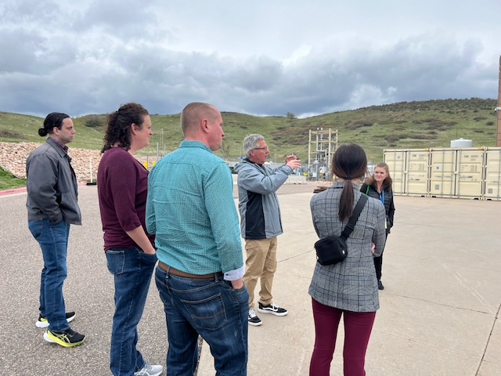
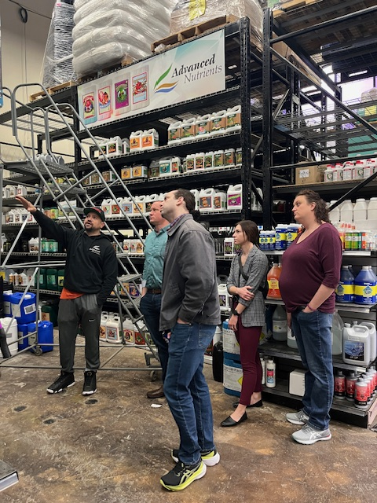
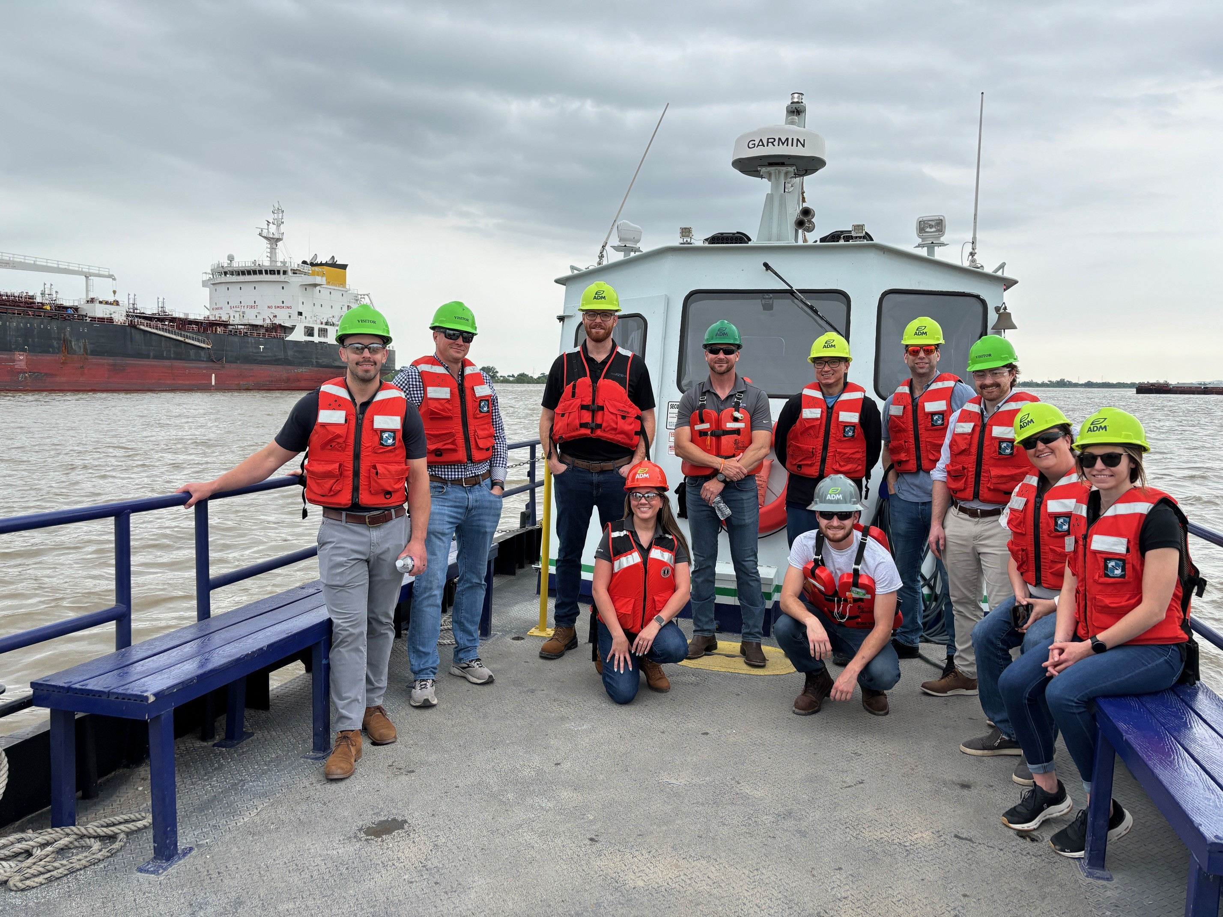
Economics Committee
  The committee is strengthened by having a wide representation of membership.
  Opportunity to offer guidance and share insights on in-progress projects and products, as well as Market and Logistics Conference programming
  Help guide decisions on priorities and identify initiatives that would deliver the greatest value to members
  Sounding board on economic elements of policy issues
  Meet in person twice a year:
  Once in May, which includes a site tour
  Once in October at the beginning of the Market and Logistics Conference

Slide 14
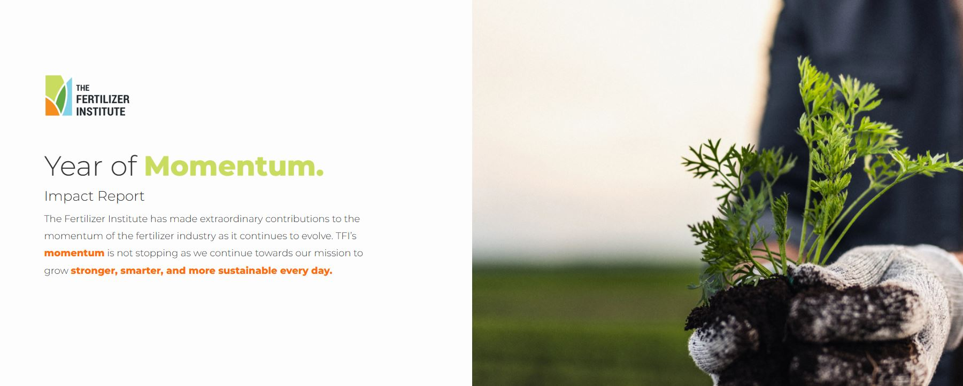
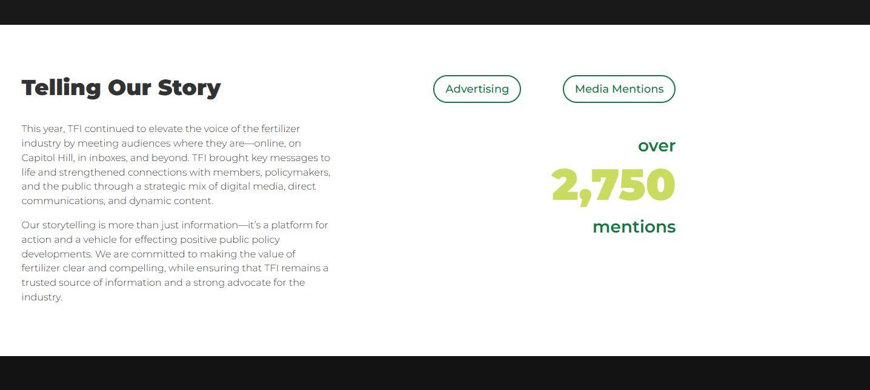

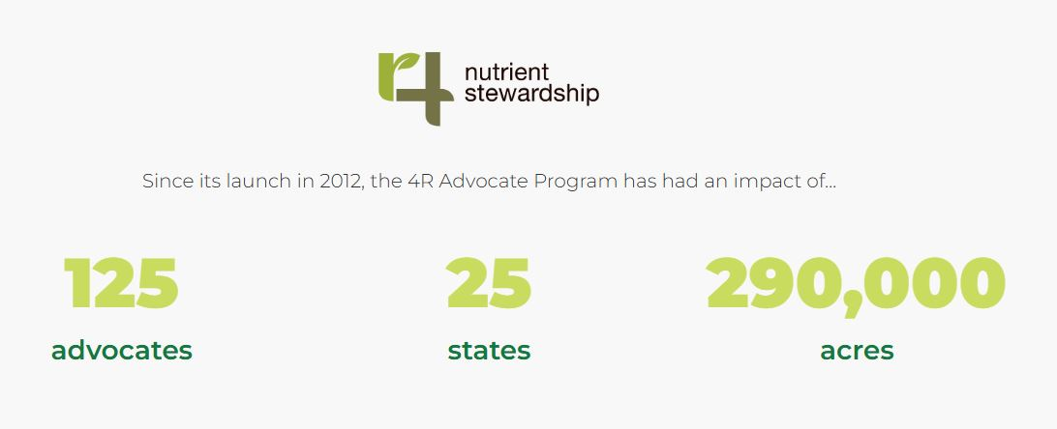

TFI Annual Report

Slide 15
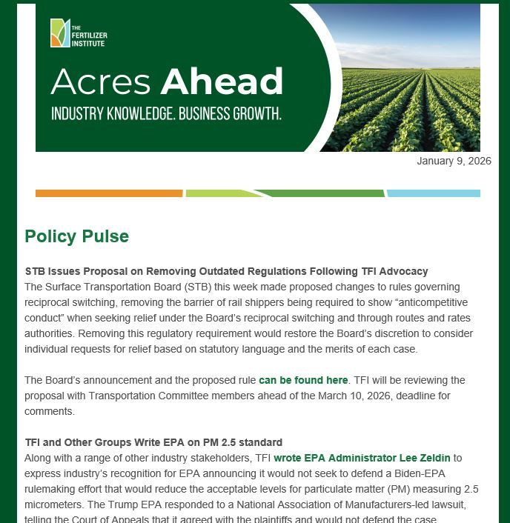
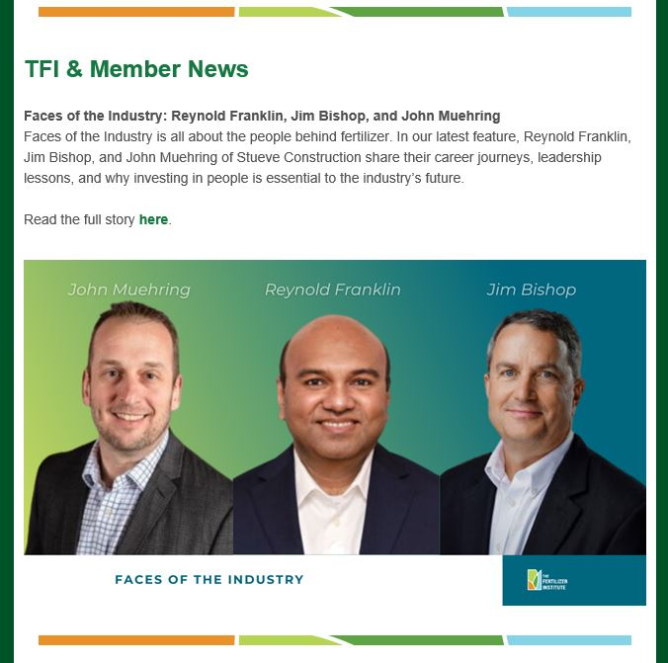
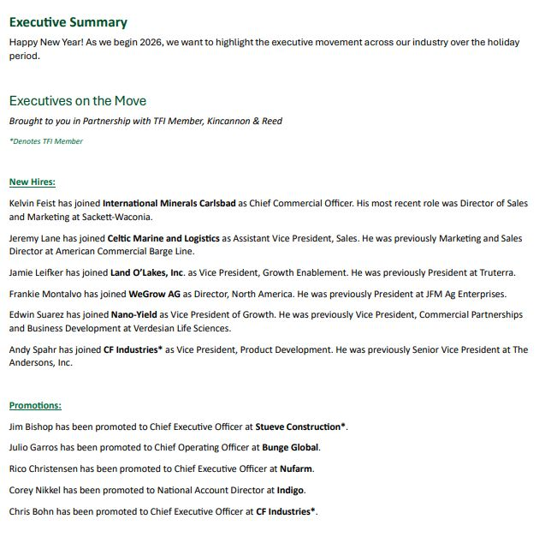
Member Communications

Slide 16
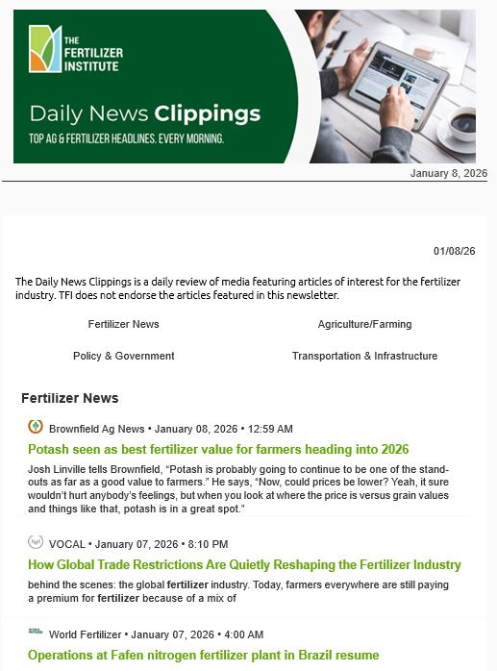
Member Communications

Slide 17

Faces of the Industry

Slide 18
Fertilizer: Life’s Main Ingredient
Primary Audience: Household food purchasers (women 25-50, dietary advocates, MAHA moms)
Objective: Educate and positively influence the perception of fertilizer to priority audiences of the public as well as students/teachers by highlighting the importance of fertilizer to personal health and the sustainable use of fertilizer to grow abundant crops
Secondary Audience: Teachers and students (via Nutrients for Life)

Slide 19

QUESTIONS?

Slide 20
Thank You!

Slide 21

Notes:
The Fertilizer Institute supports members of the fertilizer supply chain in navigating regulatory challenges and building strategic partnerships through expert advocacy, networking, and industry-leading certification programs, empowering members to influence policy and amplify their impact on the industry.

Slide 22



Board of Directors
Committees Communicate Progress on Work and Proposals for New Initiatives
The Board Provides Strategic Oversight and Approves Committee Work
Policy & Program Committees

Slide 23

Policy Committees
Program Committees
Sustainability
Communications
Biostimulants
Product Quality and Technology (PQT)
Economics
Sector Councils

Slide 24
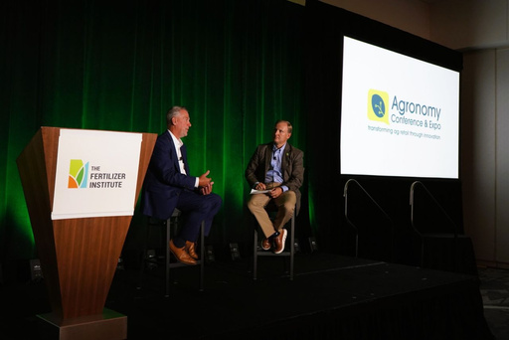

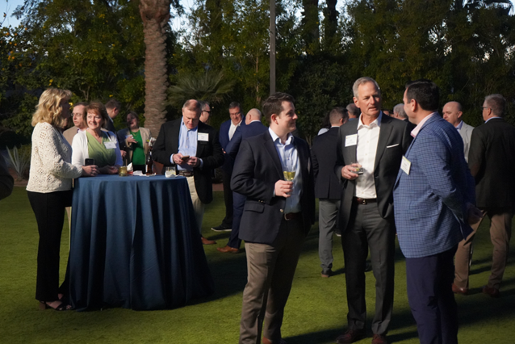



Engagement Opportunities
The Fertilizer Institute (TFI) hosts several conferences every year. These events deliver the most current information on industry trends and policy and regulatory issues, while also creating an environment for exceptional networking opportunities with TFI member firms, fertilizer industry leaders and decision makers.

Slide 25
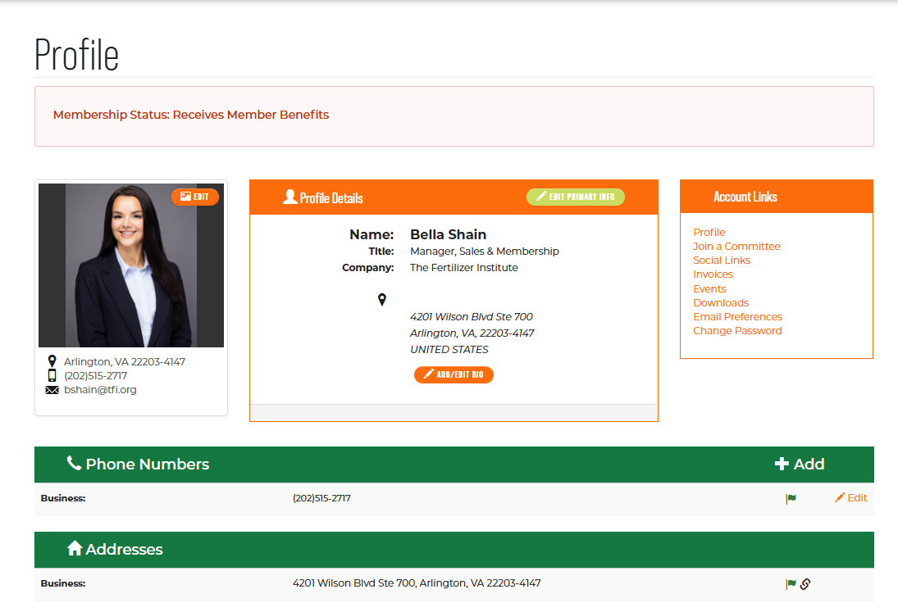
MEMBERSHIP PROFILE

Slide 26
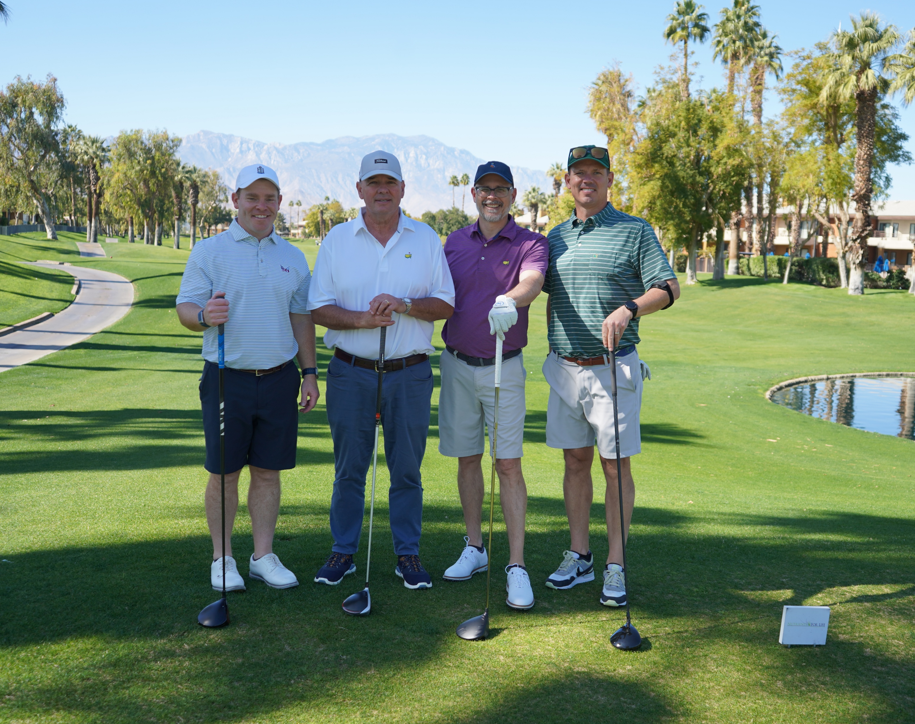
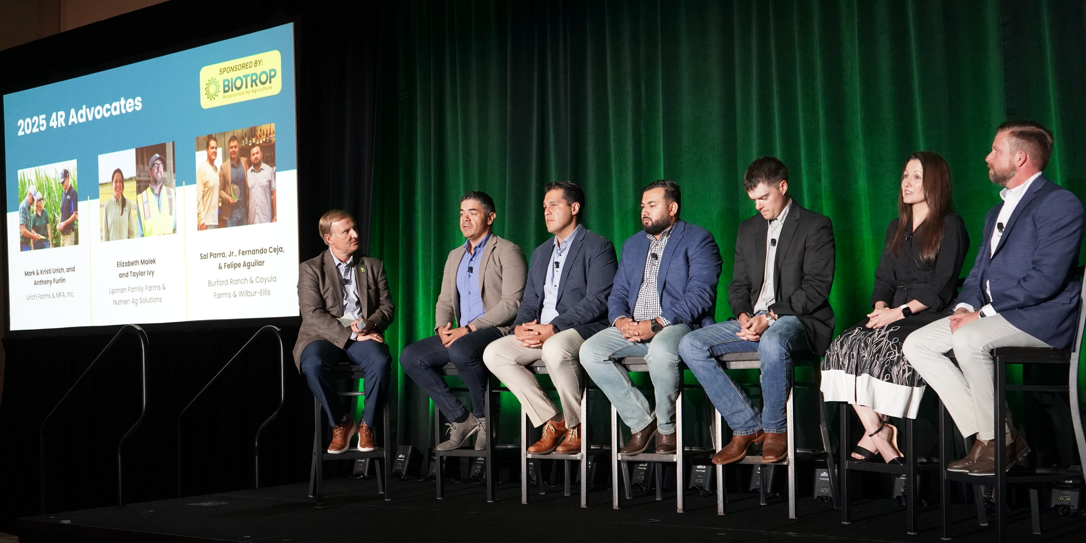
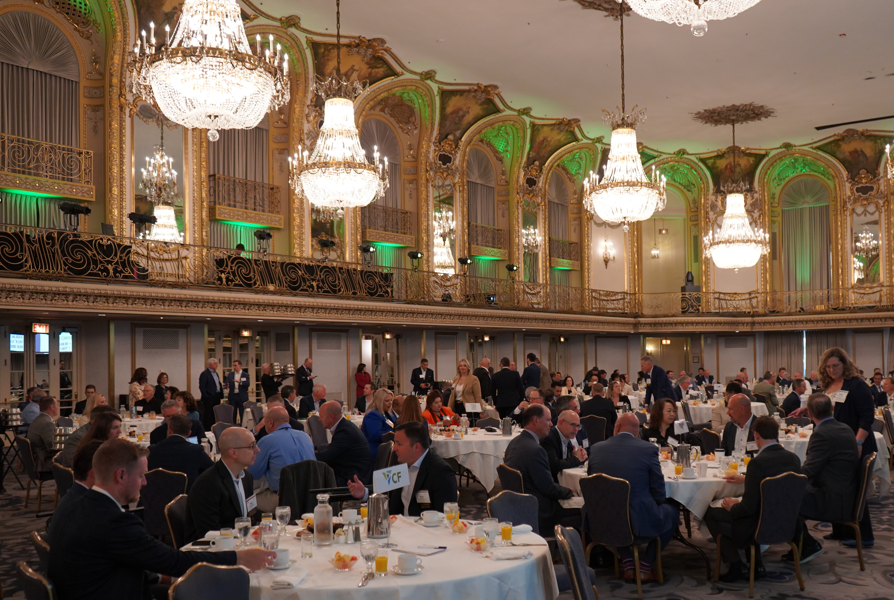

Business Development Opportunities
As a TFI member, you gain exclusive opportunities to elevate your brand and build industry awareness:
Sponsor any TFI conference
Share your expertise through educational webinars for fellow members
Advertise in Acres Ahead, TFI’s weekly newsletter

Slide 27


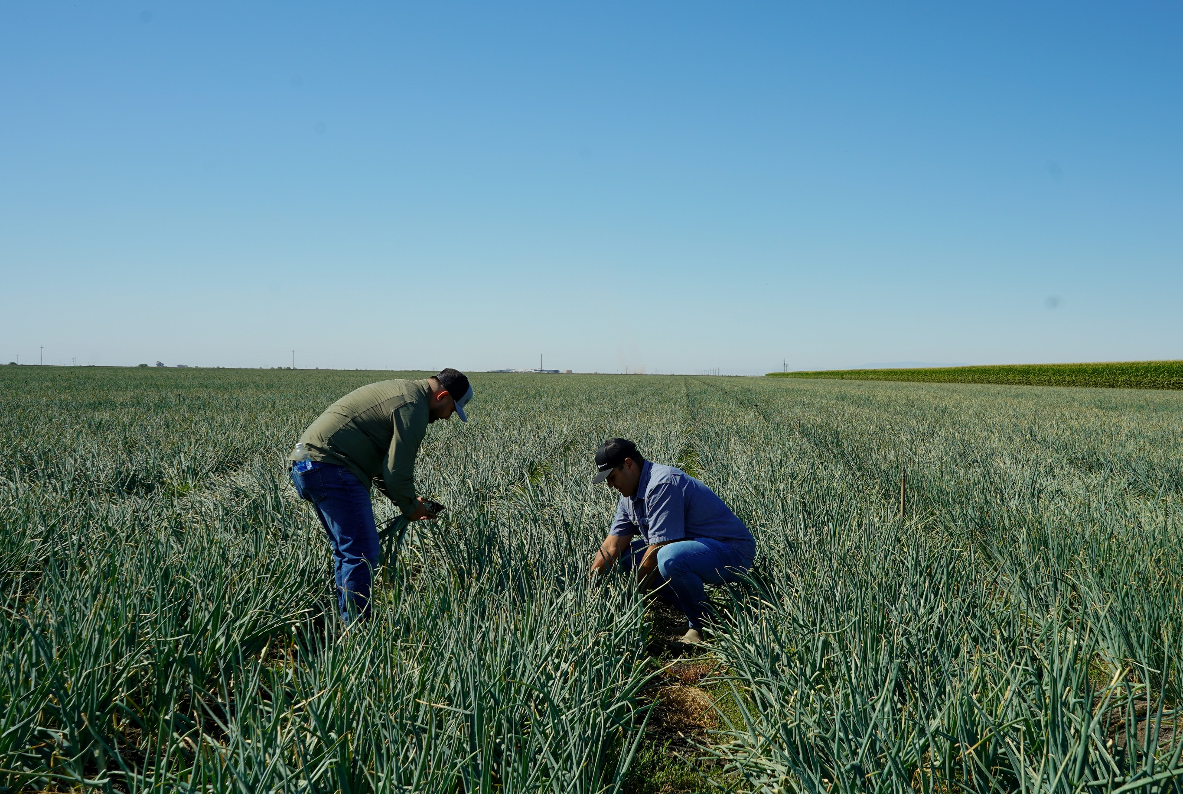
  By providing essential crop nutrients, the fertilizer industry enables the world's farmers to grow more food on less land.
  The fertilizer industry is continuously driving innovative solutions that balance productivity and sustainability.
  Improving production efficiency
  Reducing emissions
  Empowering growers to optimize nutrient use efficiency
    Nutrient stewardship focused tools, research, and products
  Related TFI Programs: 4R Advocates, The Agronomy Conference, Annual Sustainability Report, Certified Biostimulant, Verified Ammonia Carbon Intensity (VACI), and others!
Sustainability Initiatives

Slide 28

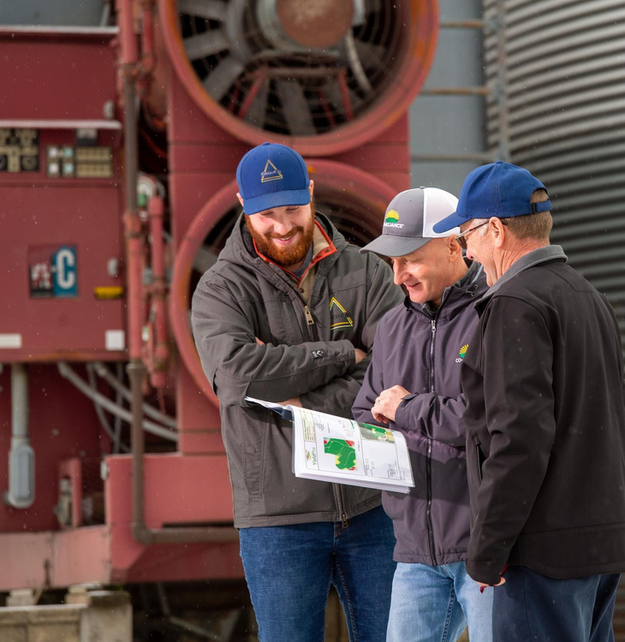
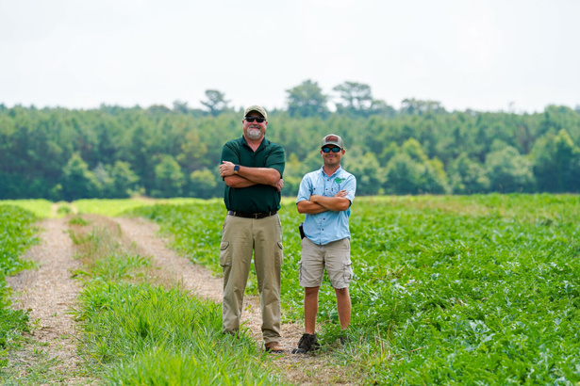
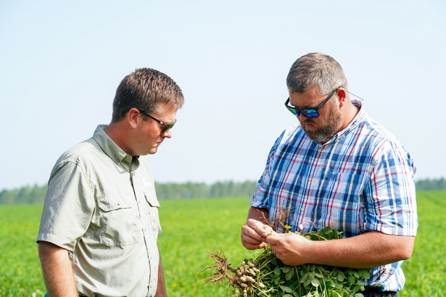
4R NUTRIENT
STEWARDSHIP
Actively considering all management practices and site-specific characteristics when making the right source, right rate, right time, and right place nutrient management decisions
Notes:
4R nutrient stewardship provides a framework to achieve cropping system goals – increased production, increased farmer profitability, enhanced environmental protection, and improved sustainability. To achieve those goals the 4Rs utilize fertilizer best management practices that address the Right Fertilizer Source, applied at the Right Rate, the Right Time and in the Right Place. Fertilize best management practices related to the Right Source match fertilizer type with crop needs; Right Rate matches the amount of the fertilizer to the crop yields; Right Time ensures nutrients are available when the plant needs them; and Right Place ensures nutrients are located where the plant can access and use them. The four “rights” are necessary for sustainable plant nutrition management. Assessment of any planned set of practice should consider the economic, social, and environmental effects to determine whether or not it is a “right” practice for that system.

Slide 29



Advance policies to support the fertilizer industry.
Advance the economic and reputational health of the fertilizer industry.
Advance sustainable fertilizer production, distribution, and use.
Advocate for data- and science-driven policy solutions.
Advocate for the economic, environmental, and social benefits of fertilizer.
Advocate for the 4R nurtient stewardship framework to improve farm performance and reduce nutrient loss.
Promote solutions to operate in a highly competitive global market.
Promote continuous improvement through education, research, and training.
Promote pathways for industry innovation that result in positive environmental outcomes.
Champion regulatory certainty to stimulate energy resources and private capital investment.
Champion regulatory certainty to stimulate energy resources and private capital investment.
Champion environmental and business performance throughout the industry supply chain.

Slide 30

Committees & Councils
Governance Committees
Policy Committees
Program Committees
Sector Councils
  Executive Committee
  TFI Board of Directors
  FERT Board of Directors
  Nominating Committee
  Finance, Investment, & AuditCommittee
  Compensation committe
  Environment, Health, Safety & Security (EHS&S)
  Product Quality and Technology
  Transportation
  Government Affairs
  Communications
  Economics
  Sustainability
  Legal
  HR/FP&A
  Education
  Adv is or y
  Research
  Leadership
  Training
  Biostimulant
  Micronutrients
  Slow & Controlled
  Release (EEFs)
  Retail
  Transportation
  Associates

Slide 31






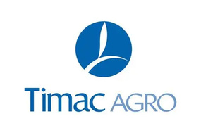


Companies with Certified Products
The Certified Biostimulant program certifies conformity to efficacy testing, safety, and composition standards as outlined in the U.S. Biostimulant Guidelines.
Companies that achieve certification will be awarded a logo to utilize:
  Helping differentiate them from competitors
  Support ag retailer product evaluations
  Build grower confidence

Slide 32
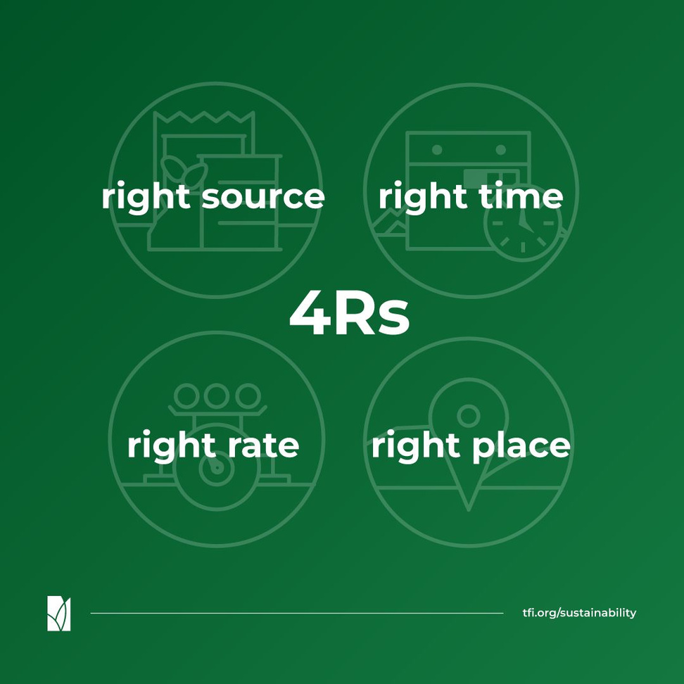
Ensure a balanced supply of essential nutrients, considering both naturally
available sources and the
characteristics of specific products, in plant-
available forms.
Assess and make decisions based on the dynamics of crop uptake, soil supply, nutrient loss
risks, and field operation logistics.
Address root-soil dynamics and nutrient movement and manage
spatial variability within the field to meet site- specific crop needs and
limit potential losses from the field.
Assess and make decisions based on soil nutrient supply and plant demand.

Slide 33
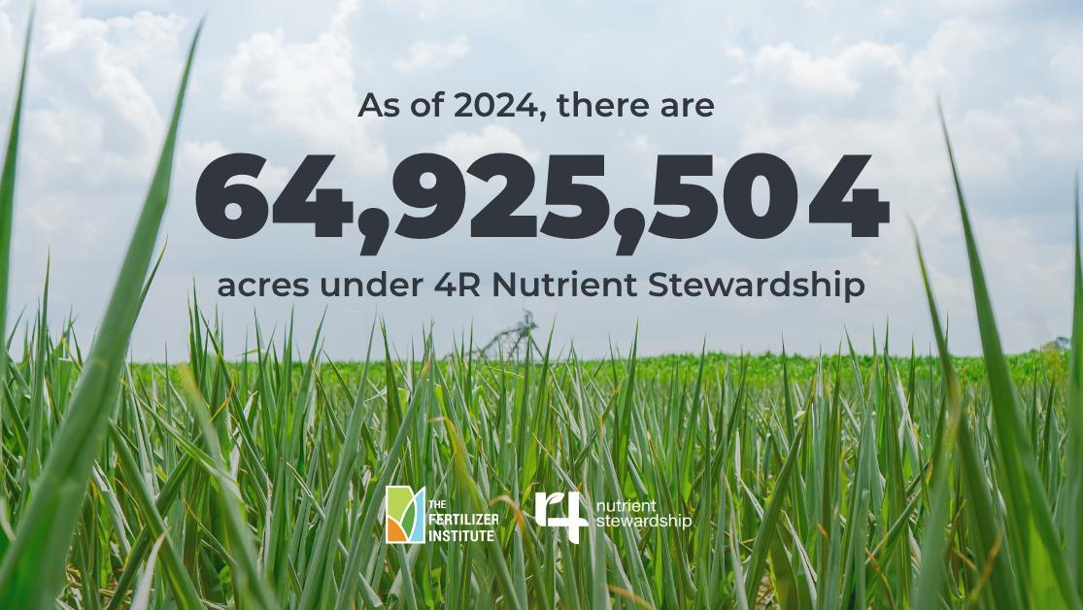

Slide 34

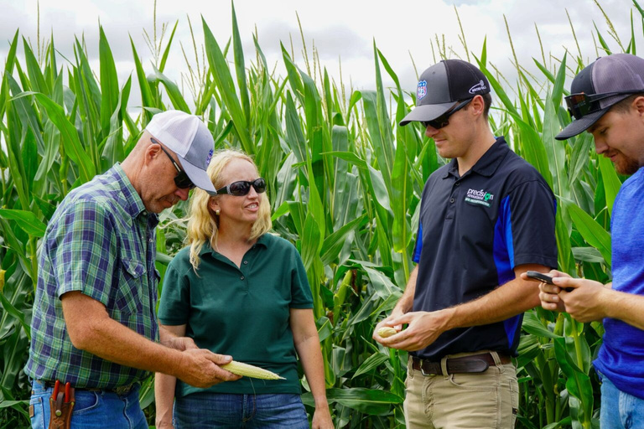
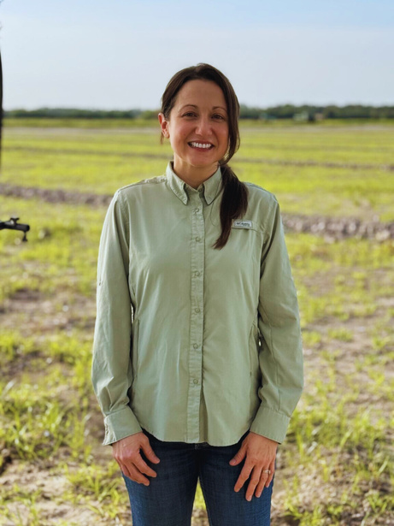
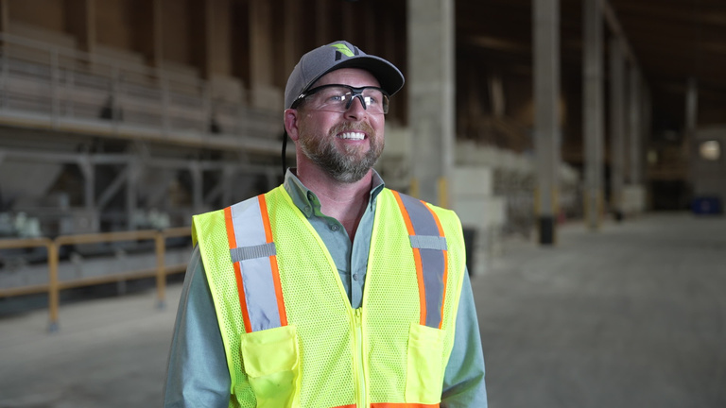

2025 4R Advocates
Mark & Kristi Urich, and Anthony Furlin
Elizabeth Malek
and Taylor Ivy
Sal Parra, Jr., Fernando Ceja, & Felipe Aguilar
Urich Farms & MFA, Inc.
Lipman Family Farms &
Nutrien Ag Solutions
Burford Ranch & Coyula Farms & Wilbur-Ellis

Slide 35





for Industry
Communication and Story Telling
Being a 4R Advocate is more than sustainability. It allows farmers to be directly involved in the telling of our story through media engagement, meetings with legislators and environmental groups, and serving as event speakers.

Slide 36

INHERITED RESEARCH FOUNDATIONS

Slide 37

FUNDED PROJECTS

Slide 38


Slide 39





Slide 40

Fertilizer Reporting Solutions
Managing fertilizer tonnage reporting can be complex, with varying schedules, forms, and rates across states. Fertilizer Reporting Solutions (FRS) is a member-driven, state-official-approved online tool designed to streamline and simplify the reporting process.
  Reporting information for 32 states
  All content is available for download in PDF or Excel format
  State pages and information are approved by state officials
  Subscription rates are based on number of states a company has fertilizer products registered in and/or sells fertilizer products into as well as TFI membership.
Ask about our frs webinar you can watch a recording of to learn more!

Slide 41







Fertilizer Education Research Training
Education
training
research
Notes:
The FERT Foundation is the fertilizer industry’s foundation focused on efforts surrounding fertilizer education, research, and training.

Slide 42










Rooted in Research
BUILDING A STRONG SCIENTIFIC FOUNDATION THROUGH INDUSTRY-FUNDED RESEARCH ​
RESEARCH STRATEGY
CORE ELEMENTS
4R Field-Based Applied Research
OUR COMMUNICATION PATHWAYS
Partner with Research Institutions
4R Farming & ​
Nutrient Stewardship Websites​
TFI’s Members-Only Newsletter​
Acres Ahead​
Dissemination Research
Farmer Case Studies​
Position
Statements
Scientific Advisory Network
Promote 4R Resources and Tools
Issue Briefs Focused on Congressional Advocacy​
TFI’s Story of Fertilizer Monthly Newsletter​
Outside media (Crops & Soils Magazine)
Social Media Campaigns
Private Industry Research

Slide 43

Ford West Leadership Academy
The Next Generation of Leaders
The Ford West Leadership Academy is designed to develop the next generation of leaders in the fertilizer industry. Participants in this two-year training program will gain exposure to all facets of the fertilizer supply chain, enhance both technical and soft skills, and build invaluable industry connections.

